Slide 1

Cypress-JavaScript Knowledge Transformation

Slide 2
Javascript Intro - Basics to Know About

Slide 3


What is JavaScript?
JavaScript was initially created to “make web pages alive”.
Scripts (codes) can be written right in a web page’s HTML and run automatically as the page loads.
Scripts are provided and executed as plain text. They don’t need special preparation or compilation to run.
In this aspect, JavaScript is very different from another language called Java.

Slide 4
JavaScript Run Environments
Today, JavaScript can execute not only in the browser, but also on the server, or actually on any device that has a special program called the JavaScript engine.
The browser has an embedded engine sometimes called a “JavaScript virtual machine”.
Different engines have different “codenames”. For example: V8 – in Chrome, Opera and Edge.

Slide 5
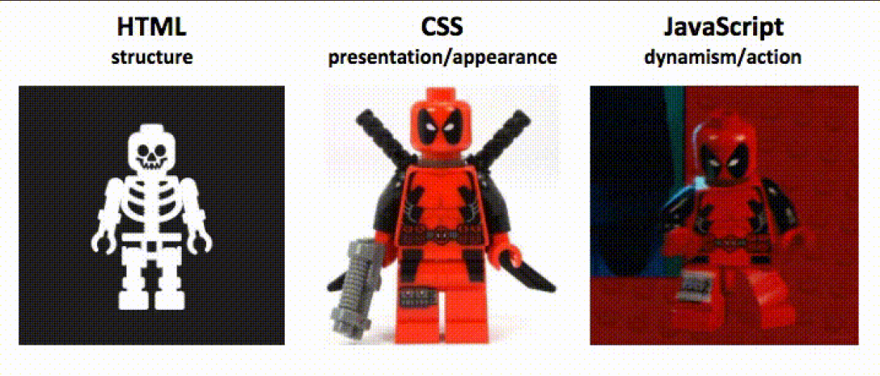
The Role of JavaScript
JavaScript is one of the three core technologies of web development. For instance, in-browser JavaScript is able to:
React to user actions, run on mouse clicks, pointer movements, key presses.
Send requests over the network to remote servers, download and upload files.
Get and set cookies, ask questions to the visitor, show messages.

Slide 6

Where do we put JS code?
The <script> tag contains JavaScript code which is automatically executed when the browser processes the tag.
// Script files are attached to HTML with the src attribute
<script src="/path/to/script.js"></script>

Slide 7
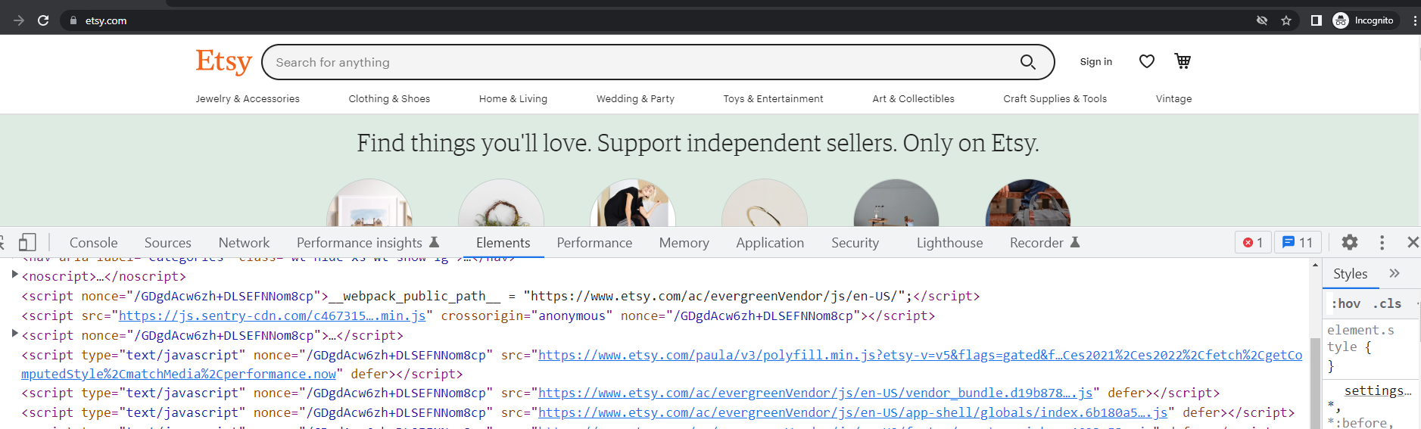
How do we see JS code on a Browser Page?
Let’s learn how to open Developer console of Google Chrome: Press F12 or, if you’re on Mac, then Cmd+Opt+J.

Slide 8
Code Structure and Running Codes

Slide 9
Hello World!
Let’s write our first JavaScript code:
Assuming we have installed VSC, Node.js, and extension (CodeRunner)
Create a folder named JavaScriptProgramming on Desktop
Open folder in VSC and Create Variables.js file

Slide 10
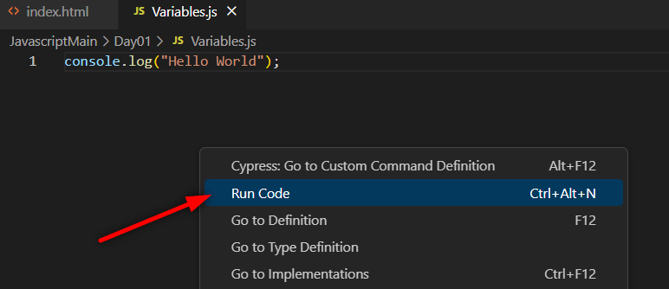

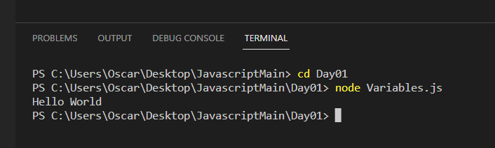
Hello World!
Run your codes with Node.js engine in your computer with Code Runner extension
Or running your code from Terminal

Slide 11
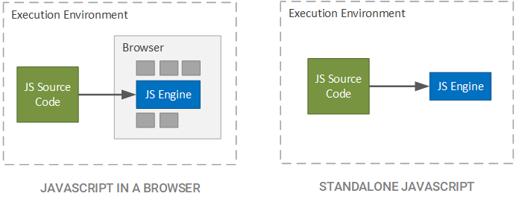
Javascript Virtual Machine Browser vs Node.js
HTML file needed: Runs on browser JS Virtual Machine
No HTML file: Runs on Node.js Machine

Slide 12
Code structure
Statements : are syntax constructs and commands that perform actions.
// A semicolon may be omitted in most cases when a line break exists.
console.log(‘Hello World’);

Slide 13
Variables and Data Types in JS

Slide 14
Variables
// The statement below creates (in other words: declares) a variable with the name “message”:
let message;
// store the string 'Hello' in the variable named message
message = 'Hello';
Variable is a named container for a particular type of data used to hold a value.
Storing data
Manipulate Values
Writing Flexible Code
Enhance Code Readability

Slide 15


Task-1 Working with variables
Declare two variables: admin and firstName.
Assign the value "John" to firstName.
Copy the value from firstName to admin.
Show the value of admin using console.log()
Example:
Input:
firstName = John
Output:
admin = John

Slide 16
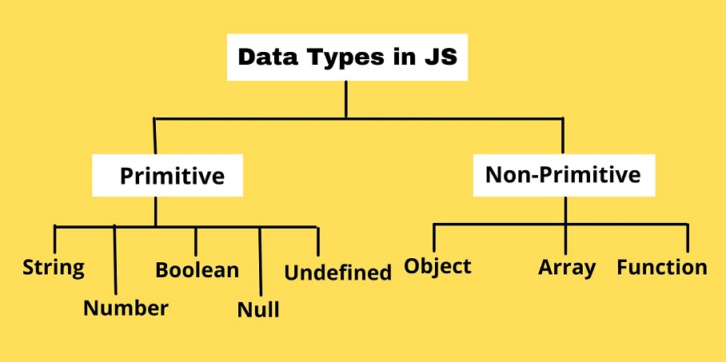
Data Types
Primitive: String, Boolean, Number
Undefined and Null
Object
Array and Function

Slide 17
Strings in JS

Slide 18
Strings
// Double quotes:
console.log("Hello”);
// Single quotes:
console.log('Hello’);
// Backticks:
console.log(`Hello`);
In JavaScript, there are 3 types of quotes.
Double and single quotes are “simple” quotes. There’s practically no difference between them in JavaScript.
Backticks are “extended functionality” quotes. They allow us to embed variables and expressions into a string by wrapping them in ${…}

Slide 19
Operators in JS

Slide 20
Basic operators, maths
Math operations are supported in JavaScript
Addition + and Subtraction -
Multiplication * and Division /
Remainder %
Exponentiation **

Slide 21
Increment/decrement
Increasing or decreasing a number by one is among the most common numerical operations. So, there are special operators for it:
Increment ++ increases a variable by 1
Decrement -- decreases a variable by 1
The operators ++ and -- can be placed either before or after a variable.
When the operator goes after the variable, it is in “postfix form”: counter++.
The “prefix form” is when the operator goes before the variable: ++counter.
The prefix form returns the new value while the postfix form returns the old value (prior to increment/decrement).

Slide 22
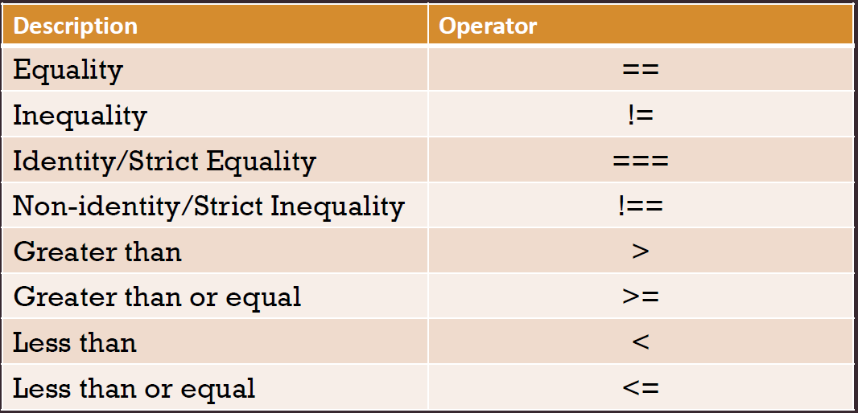
Comparison Operators
Boolean is the result
All comparison operators return a boolean value
true – means “yes”, “correct” or “the truth”.
false – means “no”, “wrong” or “not the truth”.

Slide 23
Logical operators
|| (OR)
The “OR” operator is represented with two vertical line symbols
&& (AND)
The AND operator is represented with two ampersands &&
Precedence of AND && is higher than OR ||
So the code a && b || c && d is essentially the same as if the && expressions were in parentheses: (a && b) || (c && d).
! (NOT)
The boolean NOT operator is represented with an exclamation sign !.

Slide 24
Conditional Branching in JS

Slide 25
Conditional branching: if, if else
Sometimes, we need to perform different actions based on different conditions. To do that, we can use the if statement
// if condition is true code block is executed
if(score >= 50){
congratulate();
}

Slide 26
“question mark” operator
The so-called “conditional” or “question mark” operator lets us do that in a shorter and simpler way.
The operator is represented by a question mark ?. Sometimes it’s called “ternary”, because the operator has three operands. It is actually the one and only operator in JavaScript which has that many.
The syntax is:
let result = condition ? value1 : value2;
If condition is true, result is value1, if wrong result is value2

Slide 27
Loops in JS

Slide 28
Loops
Each execution of the loop body is called an iteration.
Begin
“for” loop allows repeated execution of code block based on a certain number of iterations.
initialization
boolean expression
false
End
true
iteration
statements
iterator

Slide 29
Arrays and Data Structures in JS

Slide 30
Arrays and Data Structures
There is no Collection in JS. In JS we only have Arrays and Map
Arrays are NOT Fixed size
There are two important Brackets in JS
1. [] ----> creates an Array
2. {} ----> creates an object

Slide 31
Functions in JS

Slide 32
Functions
Functions are the main “building blocks” of JS. They allow the code to be called many times without repetition.
// To create a function we can use a function declaration.
function showMessage() {
console.log( 'Hello everyone!' );
}

Slide 33
Functions
They call functions as first class citizens of Javascript
* 1. you can pass a function as an argument to other functions
* 2. you can return a function from a function
* 3 . you can store a function into a varible

Slide 34
Functions and Callback Hell
Difference between Sync and Async Codes, How to handle async functions
* Sync Code
--- Connect DB
--- gets data
--- is waiting until the data is received
--- then executes rest of the code
* in JS – Async Code:
--- while trying to connect DB
*--- the rest of the functions does not wait

Slide 35
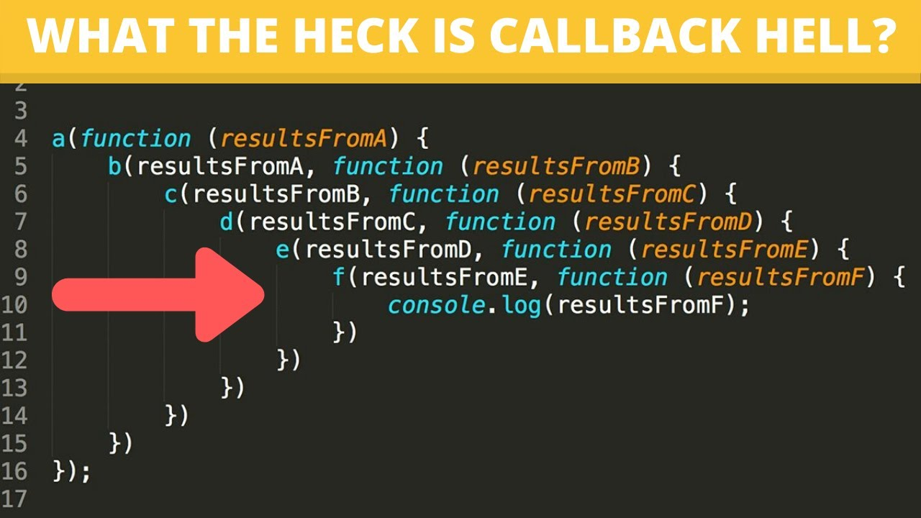
Functions and Callback Hell

Slide 36
Arrow Functions in JS

Slide 37
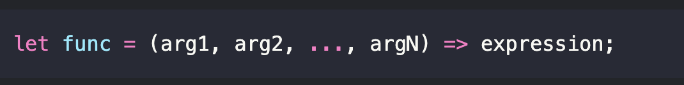
The basics of Arrow Functions
There’s another very simple and concise syntax for creating functions, that’s often better than Function Expressions.
This creates a function func that accepts arguments arg1..argN, then evaluates the expression on the right side with their use and returns its result.

Slide 38
Objects in JS

Slide 39
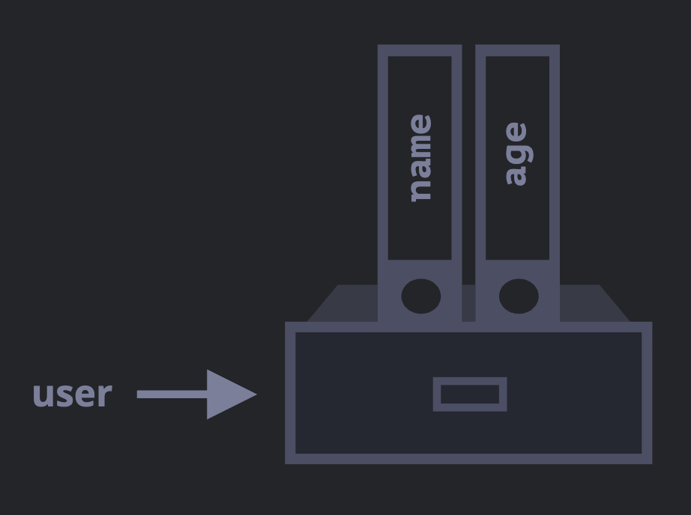
Objects
An object can be created with figure brackets {…} with an optional list of properties.
A property is a “key: value” pair, where key is a string (also called a “property name”), and value can be anything.

Slide 40
Object Actions
add new property to an object
We can add, remove and read files from it at any time.
Property values are accessible using the dot notation
check a property if it exists
put arrays, objects or functions inside objects
loop using keys of the object

Slide 41
JavaScript Promise Object

Slide 42
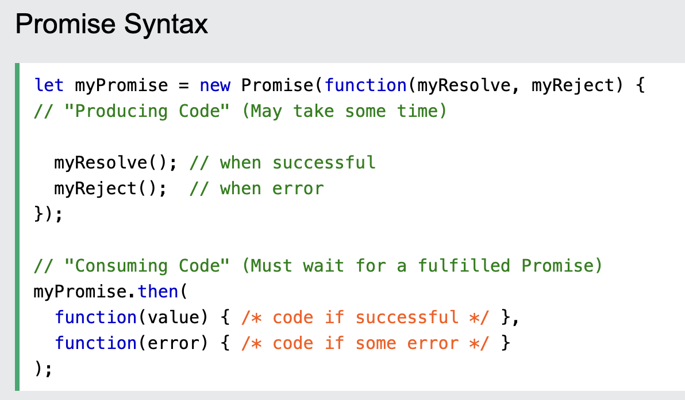
Promise Objects in JS
A JavaScript Promise object contains both the producing code and calls to the consuming code.
A JavaScript Promise object can be:
Pending
Fulfilled
Rejected

